Slide 1






















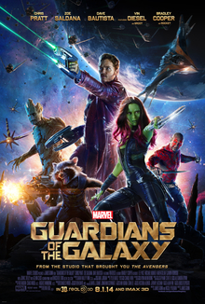


Can Pre-Movie Hype Predict Box Office Results?
Baskar Dakshinamoorthy, Randy Geszvain, and Reed McElfresh
Notes:
Images from Wikipedia, https://warnerbros.fandom.com/wiki/DC_Extended_Universe,

Slide 2
Background
The movie industry is an economic juggernaut
2018 total box office results were $96.8 Billion
Average film budget is going up every year
Notes:
MPAA 2018 Theme Report: https://www.mpaa.org/wp-content/uploads/2019/03/MPAA-THEME-Report-2018.pdf

Slide 3

Franchise Films
One of the main drivers of increased budgets
Average budget since 2015 has been $ 234 Million
Generally, do very well at the box office
Nine of the top ten movies in 2018
Eight of the top ten highest grossing films of all time
Notes:
Average budget is for the films in our dataset
Per MPAA
Per https://en.wikipedia.org/wiki/List_of_highest-grossing_films#Highest-grossing_films

Slide 4
What is the risk?
Releases are planned for many years in the future
Marvel’s current schedule goes through 2020
Disney has 8 new movies planned for the Star Wars Franchise
One poorly performing movie can cause these plans to be completely rewritten.
Notes:
https://bgr.com/2019/05/08/mcu-phase-4-release-dates-avengers-endgame/

Slide 5
The Question
Can we predict the Box Office Results of the next franchise film based on previous results and the sentiment of tweets and rotten tomato reviews?

Slide 6
Scope of Project
Universe | Movie | Year
Star Wars | The Force Awakens | 2015
 | Rogue One | 2016
 | The Last Jedi | 2017
 | Solo | 2018
DCEU | Dawn of Justice | 2016
 | Suicide Squad | 2016
 | Justice League | 2017
 | Wonder Woman | 2017
 | Shazam | 2019
MCU | Guardians of the Galaxy | 2014
 | Age of Ultron | 2015
 | Ant-man | 2015
 | Captain America Civil War | 2016
 | Doctor Strange | 2016
 | Spiderman Homecoming | 2017
 | Thor Ragnarok | 2017
 | Ant-man and the Wasp | 2018
 | Avengers Infinity War | 2018
 | Black Panther | 2018
 | Avengers Endgame | 2019
Franchise films in the Marvel Cinematic Universe, DC Extended Universe, and Star Wars Universe
Released in the last five years

Slide 7
The Data
Box office results & budgets were scraped from Wikipedia and StatCrunch.com
Tweets were scraped from Twitter
Critic Reviews were scraped from Rotten Tomato
Alteryx was used to combine all of the individual movies into one data frame for sentiment analysis
Notes:
Randy

Slide 8
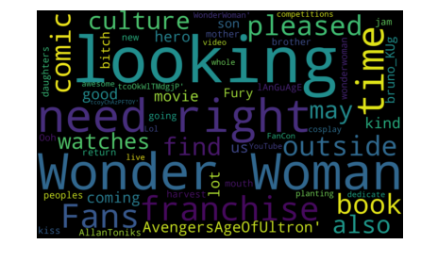
What are people Tweeting?

Slide 9

Measuring Sentiment
Valence Aware Dictionary and sEntiment Reasoner
Not just Luke’s father
Lexicon and rule-based sentiment analysis tool that is specifically attuned to sentiments expressed in social media (GitHub).
It works exceedingly well on social media type text, yet readily generalizes to multiple domains It doesn’t require any training data but is constructed from a generalizable, valence-based, human-curated gold standard sentiment lexicon It is fast enough to be used online with streaming data, and It does not severely suffer from a speed-performance tradeoff.
This Photo by Unknown Author is licensed under CC BY-NC-ND
Notes:
Baskar
https://github.com/cjhutto/vaderSentiment

Slide 10
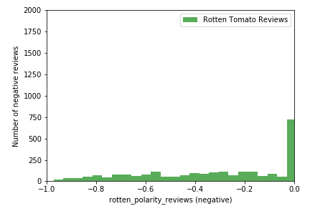
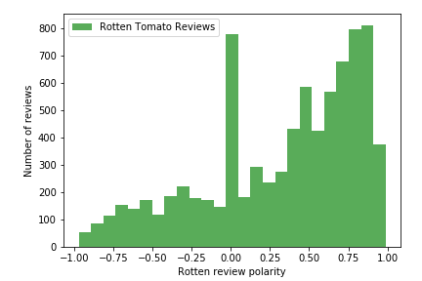
VADER Rotten Tomato Results
Count of Negative Reviews
Count of Reviews

Slide 11
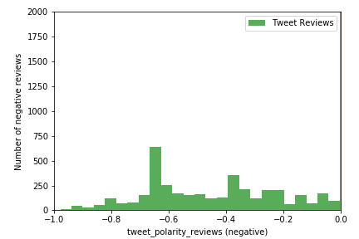
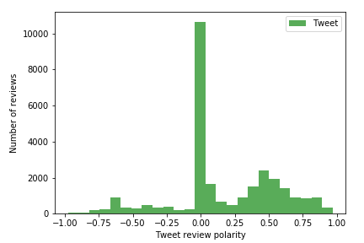
VADER Rotten Tomato Results
Count of Negative Reviews
Count of Reviews

Slide 12
Building the Model
Average sentiment of all tweets for each movie were averaged
Average sentiment of all critic reviews for each movie were averaged
A data frame was created including these averages, the box office results, budget, and month of release was created
A linear regression model was created to predict how the next movie would perform
Notes:
RANDY

Slide 13
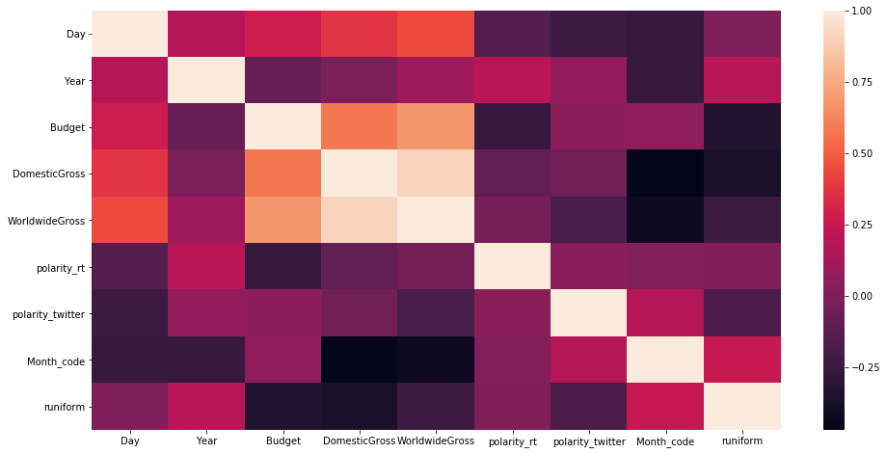
Correlation Matrix

Slide 14
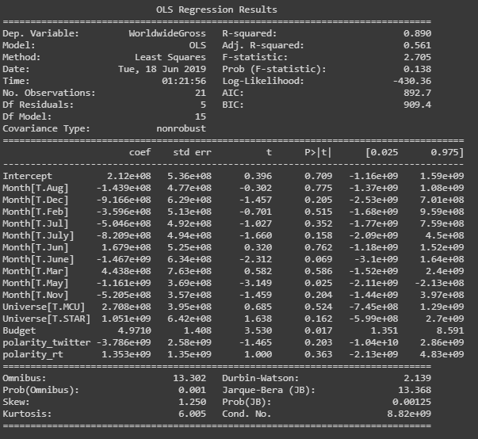
The Model
Predicts 56% of the variance in box office results
Not okay if you’re testing a drug, good enough for our purposes
Releasing in March is worth $443 M
Star Wars movies generate an extra $780 M compared to Marvel
Positive Tweets are correlated with a decreased box office outcome. Positive Critic reviews generate additional income

Slide 15

Can we predict how the next release will do?
Going to be released July 2, 2019
What do we know?
Budget: 160 Million
Current Twitter Polarity: 0.159506
Release Date: July
Universe: MCU
What don’t we know?
Critic Sentiment
Assumptions
Critic Sentiment will be average of all current sentiments (0.326592)
https://www.imdb.com/title/tt6320628/
Notes:
Reed

Slide 16
Predicted Box Office Results
$611,549,260.00

Slide 17
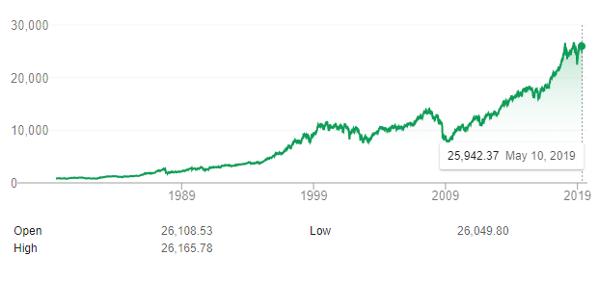
Next Steps
We’re currently only able to predict 56.1% of the variance in box office results with a 13% chance the difference is the result of random chance
Potential additional variables of interest
Number in sequence
Actor salaries
Marketing budget
Dow Jones Index
Variables that didn’t work out:
Days since last franchise film release
Days since last release in universe
Dow Jones
Notes:
https://www.google.com/search?q=dow+jones+year+end&oq=dow+jones+year+end+&aqs=chrome..69i57j0l5.4191j1j4&sourceid=chrome&ie=UTF-8

Slide 18
Questions?

